Slide 1
Simulation of World’s Highest Jumping Robot
Junlin Chen
Sanskar Nalkande

Slide 2
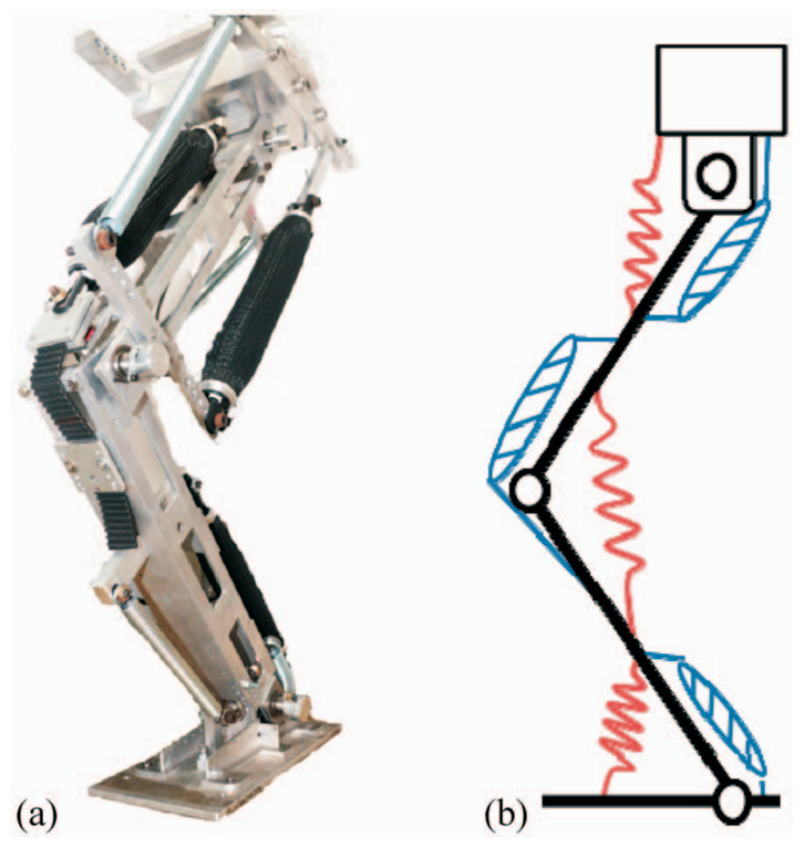
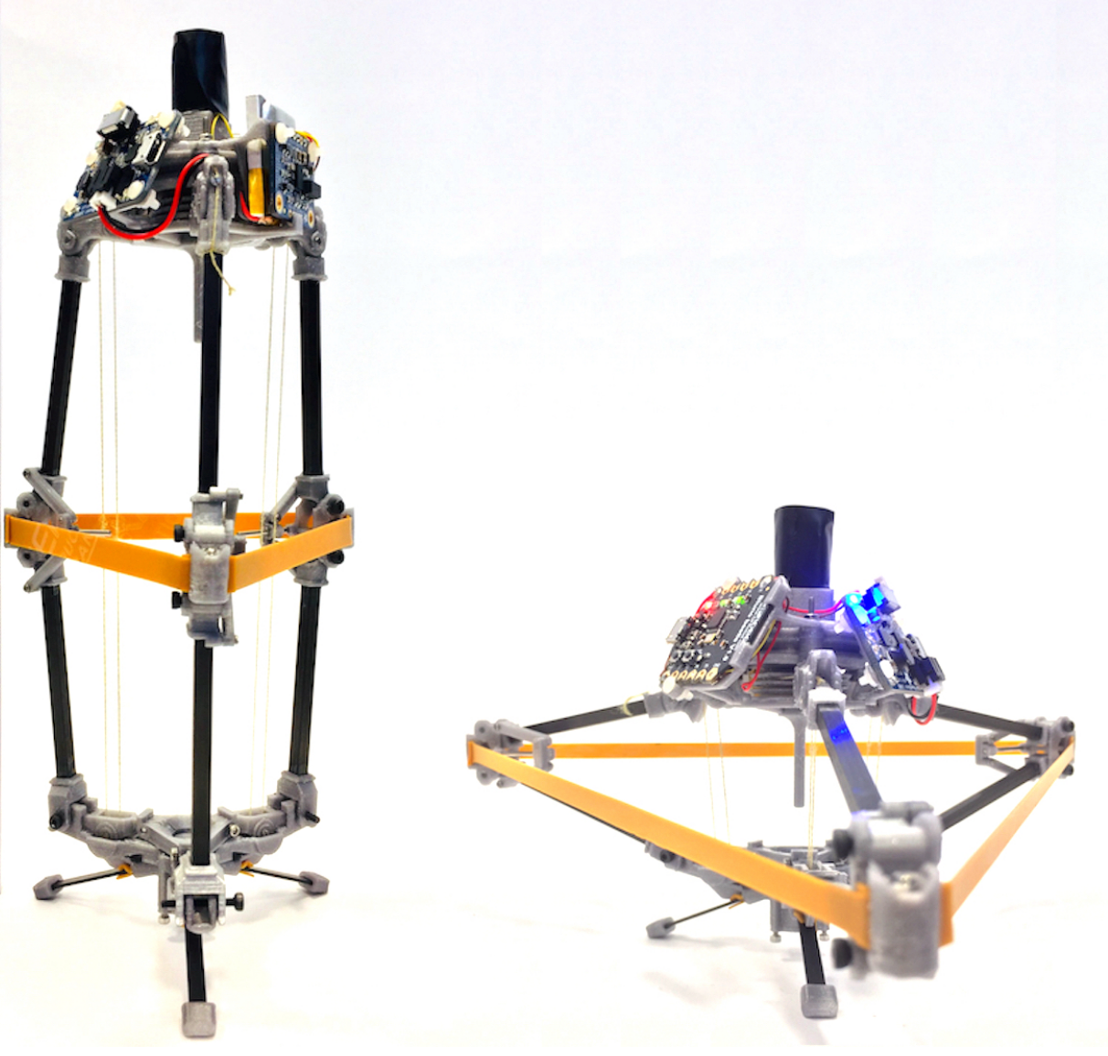
Previous Jumping Robots
Bio-mimic One-Legged Robot
Muscle, tendon, etc
Limited specific elastic energy
Demanding Structures
Engineered Multi-Legged Robot
Electric motors
Tension linkage
Still relatively limited elastic energy

Slide 3
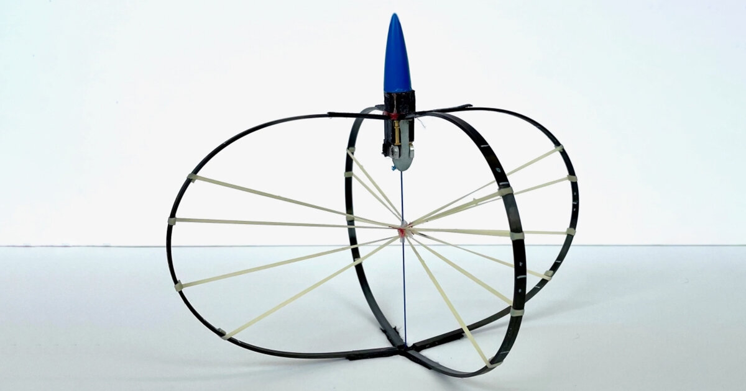
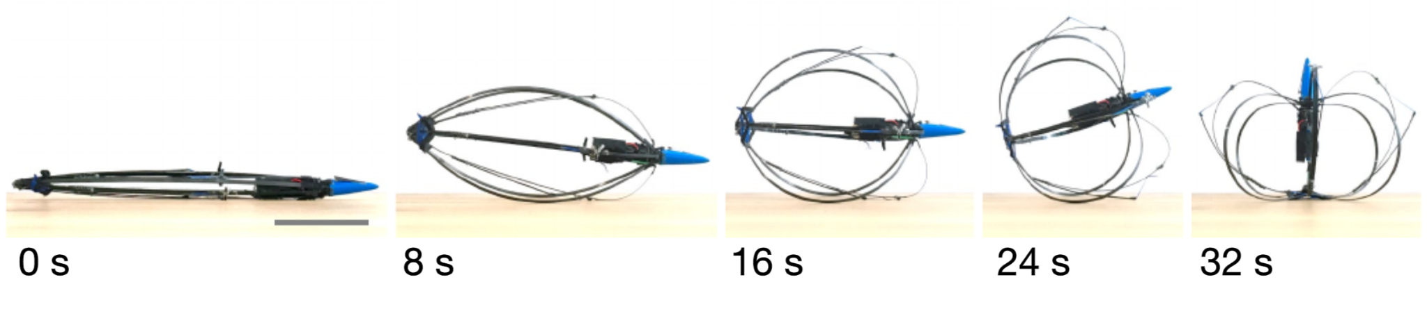
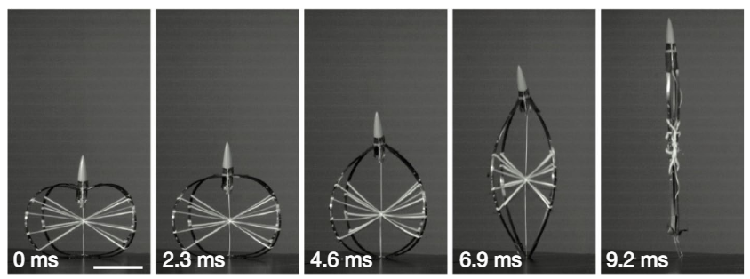
The Jumping Robot
Hybrid Tension-Compression Jumping Robot
Methodology:
-DisMech DER Simulation
Goal:
-Simulation matches real motion -Easy change of parameters and geometry

Slide 4
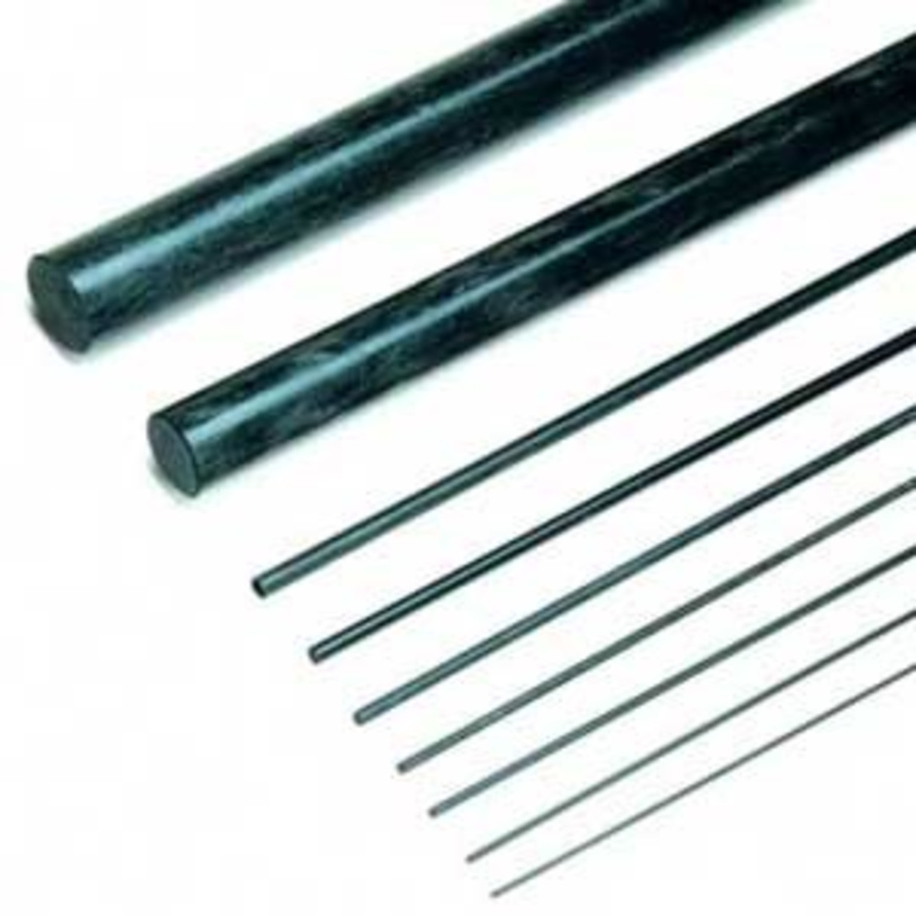
Material Properties
Carbon Fiber Rod[1]
Radius of rods = 3 mm
Young’s Modulus = 5 GPa
Density = 1.2 g/cm^3
Poisson’s ratio = 0.1
Uncompressed height of the rod = 0.3m
Latex Rubber Bands[2]
Radius = 6 mm
Young’s Modulus = 1 MPa
Density = 1.2 g/cm^3
Poisson’s ratio = 0.5

Slide 5
Simulation Environment
Parameters & Assumptions:
Time step = 10⁻⁴ s
Vertices per limb = 11
Solver tolerance = 1e-3
Iterative method: Backward Euler
Friction Ignored
Inviscid environment
No failure
Soft ground with 1e5 contact stiffness
Initial & Boundary Condition:
All nodes are free
Gravity = 1g
Initial height = 1mm
Initial velocity = 0
Uniform force applied at top cross until some time

Slide 6
Dismech Simulation Processes
Define robot physical parameters(Young’s modulus, density, etc from real world)
Define robot geometry(limbs, joints)
Define boundary and initial conditions(forces, contact, fixture, initial position)
Decide force appliance time
Decide view window
Run dismech.sh
Observe and make changes

Slide 7
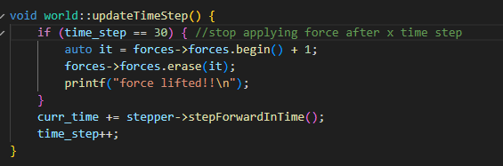
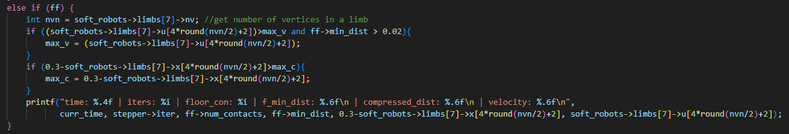


Our modifications to Dismech
class world
Ability to drop external force at certain time
Record and output max velocity/compression
Main.cpp
openglDERSimulationEnvironment.cpp

Slide 8
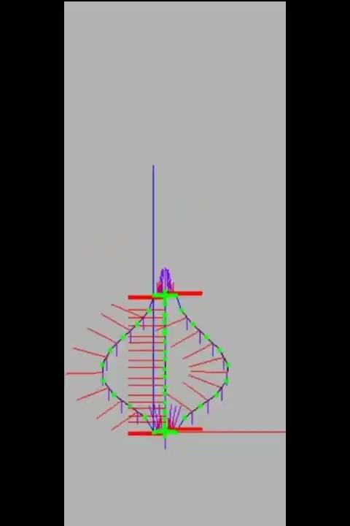
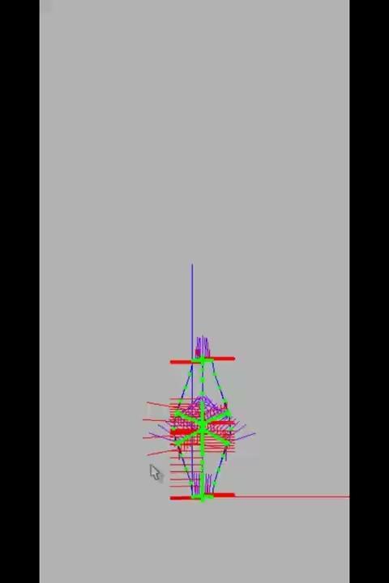
Simulation
Without Bands(Compression bow)
With Bands(Hybrid tension-compression)

Slide 9

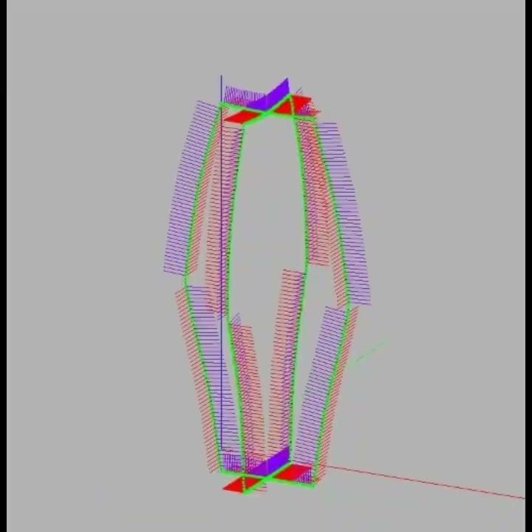
Compression Stage
Real Life
Simulation

Slide 10
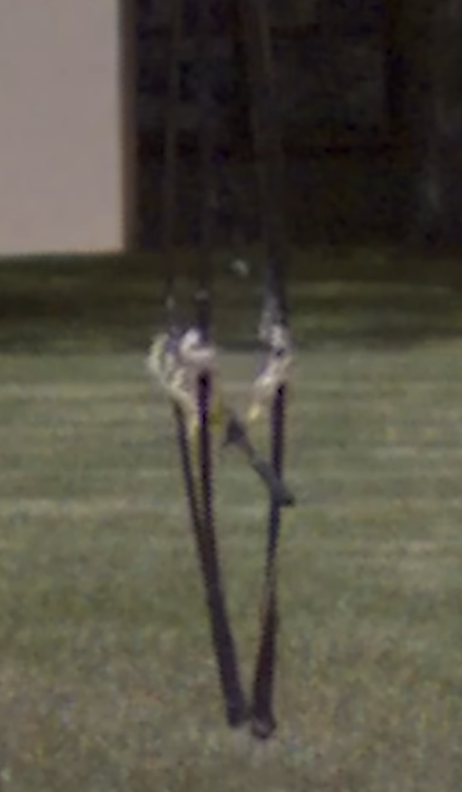
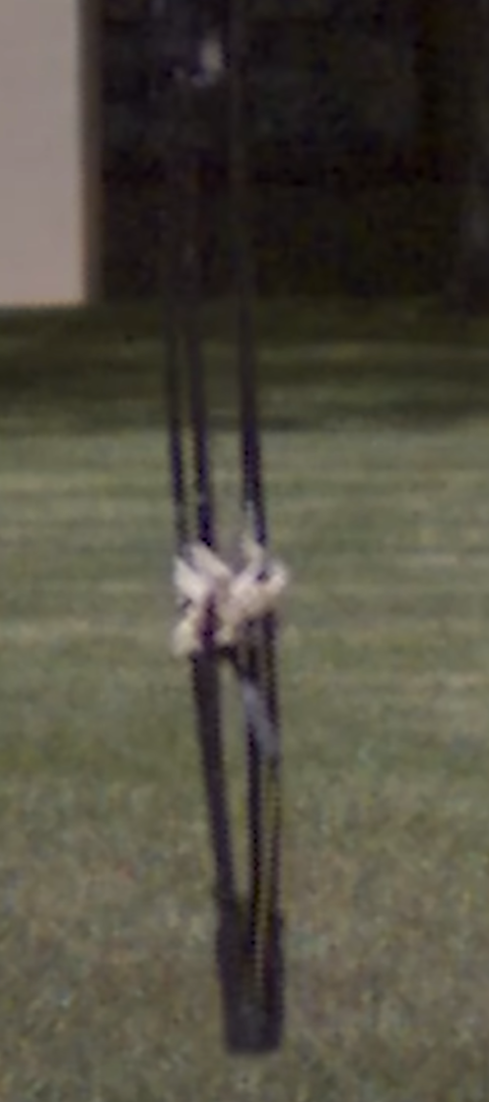
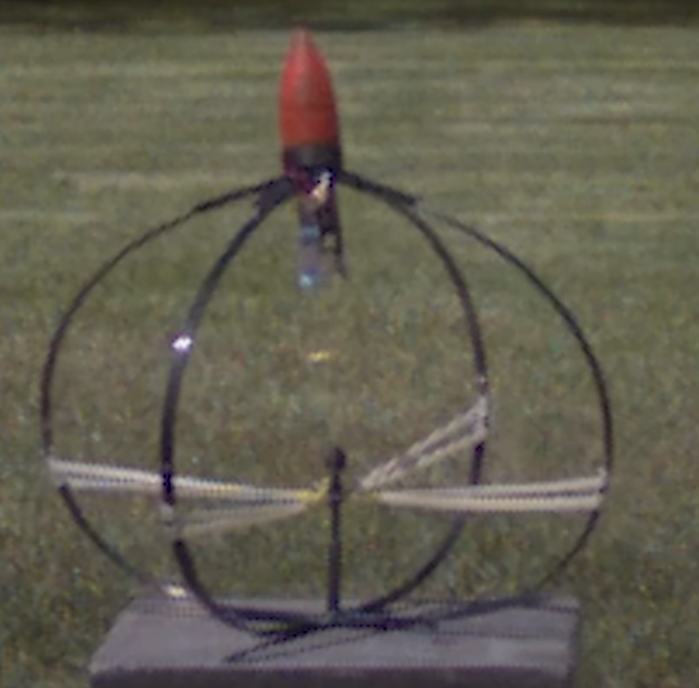
Jumping Stage
Real Life:
Simulation:

Slide 11
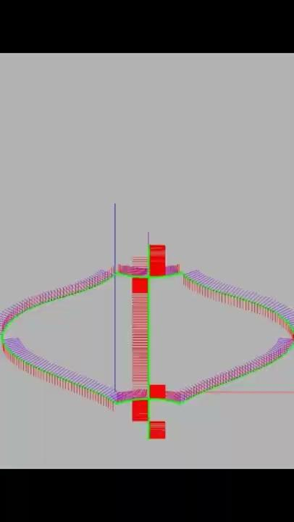
Comparison with more number of nodes

Slide 12
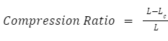
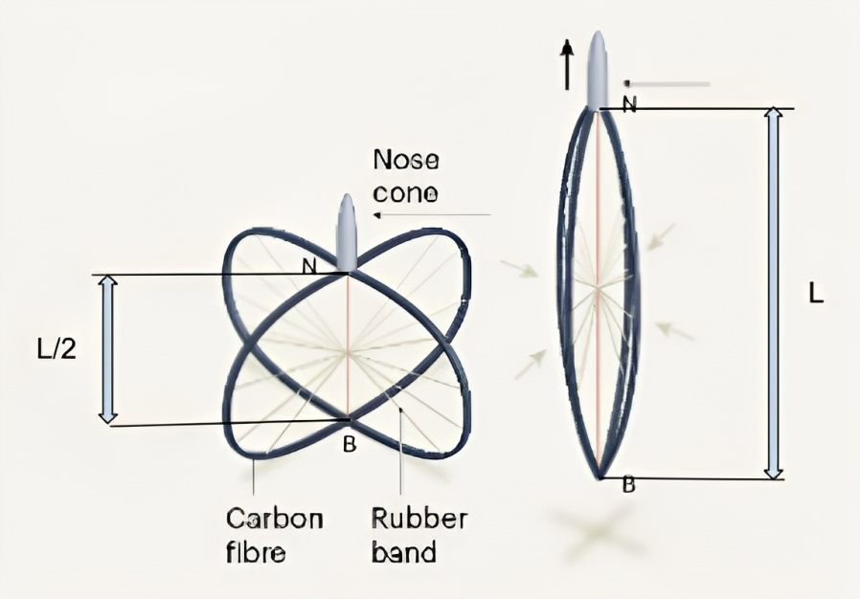
Compression ratio
We defined the compression ratio as the ratio of change in height of our robot when compressed vertically and the original height.
This ratio can be changed by changing the compressive force on the robot.
The larger the compression ratio, the larger the energy stored. Hence the robot jumps higher
L_{c}

Slide 13
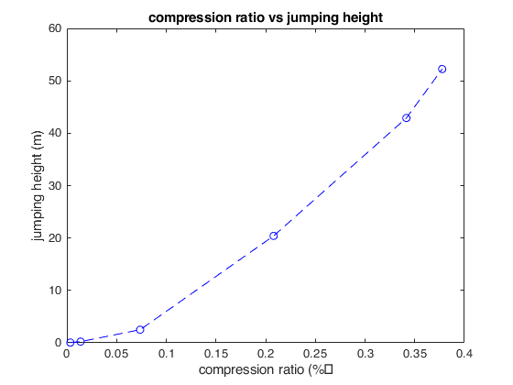
Effects of compression on maximum jumping height
Notes:
The displacement is not compression ratio, since the whole thing is bending the displacement is mostly caused by the curvature change instead of strain:
Force = 165N for all cases:
T = 0.003s, speed = 1m/s, max compression = 0.001034m
T = 0.006s, speed = 2.1m/s, max compression = 0.004135m
T = 0.009s, speed = 7m/s, max compression = 0.022115m
T = 0.012s, speed = 20m/s, max compression = 0.062415m
T = 0.015s, speed = 29m/s, max compression = 0.102477m
T = 0.018s, speed = 32m/s, max compression = 0.113278m

Slide 14
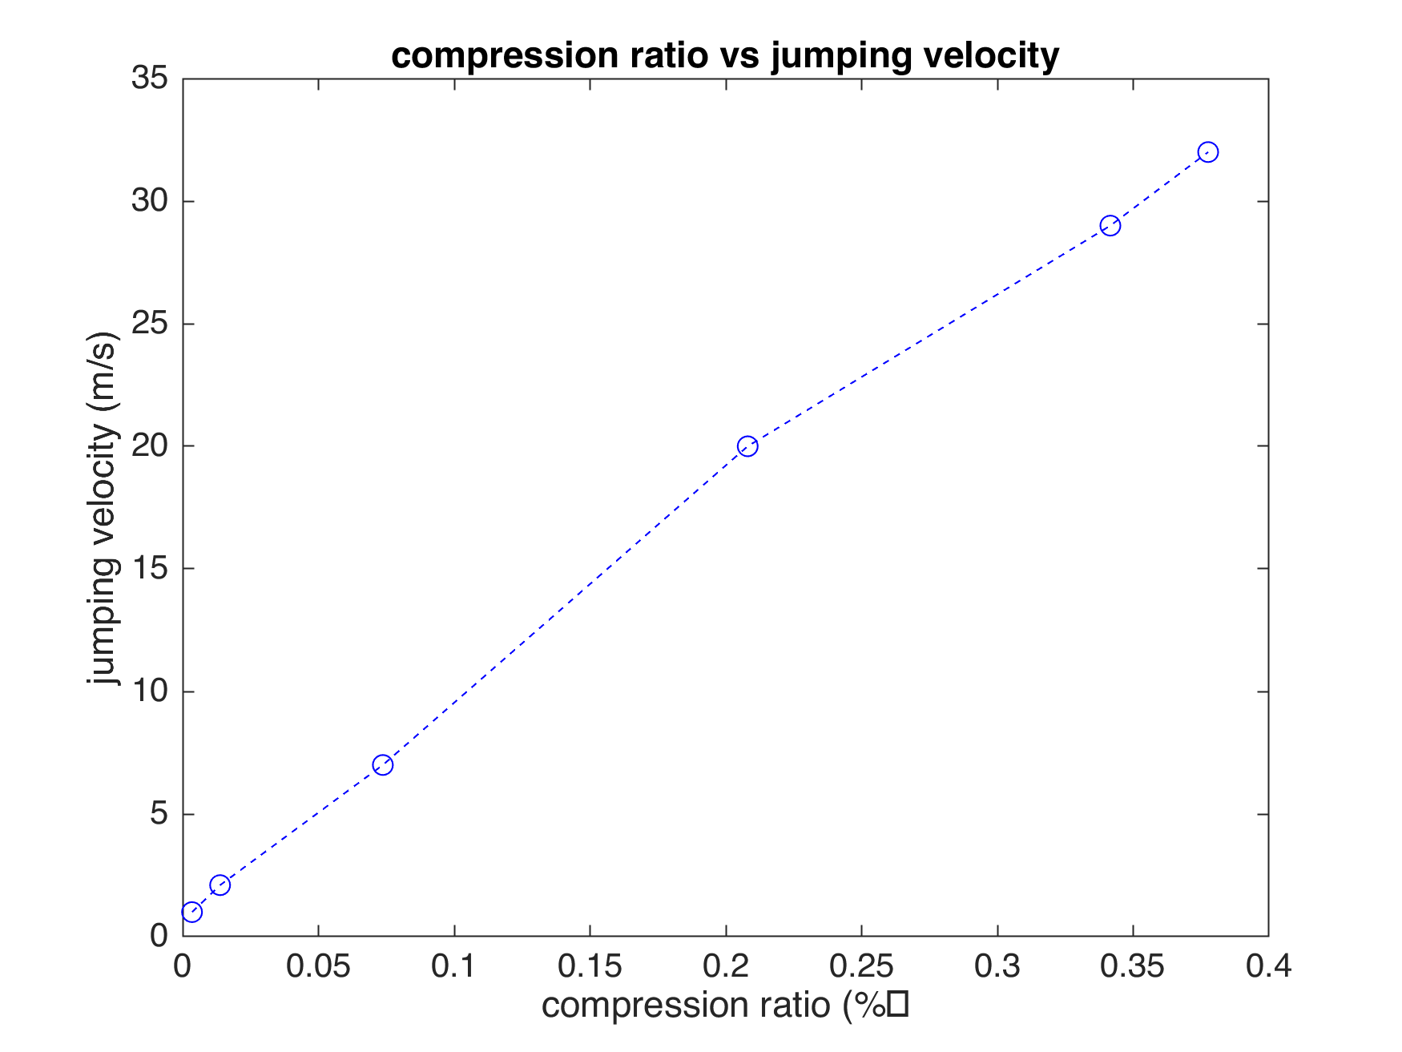
Effects of compression on launch velocity

Slide 15
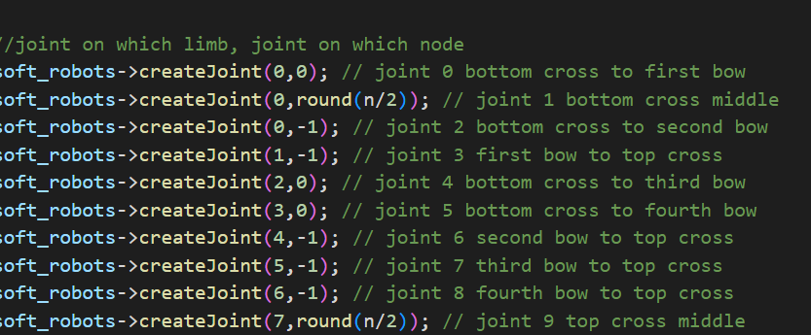
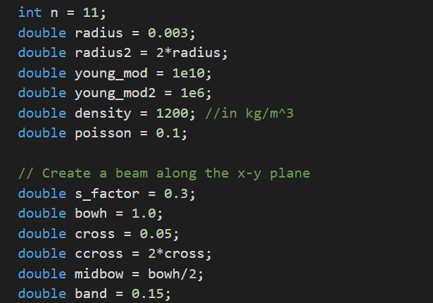
Recap
Goal:
-Simulation matches real motion
(Yes and No)
-Easy change of parameters and geometry
(Yes, if using the same limb structures)

Slide 16
Difficulties & Possible Improvements
Difficulties
Rubber band collisions(tolerance, time step, nodes number doesn’t work)
Running time(large structure)
No curvature on limbs
Can’t identify force type within forceContainer->forces
Force applied involves guessing
Improvements
Check how collision/contact is handled in dismech
Run on linux/finding optimal nodes/dt pair
Linking multiple limbs(since glued), create from .csv
Rewrite baseForce class, add identifier
Boundary condition enforced displacement

Slide 17
Sources:
[1] ACP Composites, "Mechanical Properties of Carbon Fiber Composite Materials, Fiber / Epoxy resin (120°C Cure)," APC Composites, Livermore, CA USA, Rev. A, Dec. 2014. [Online]. Available: https://store.acpcomposites.com/SSP%20Applications/NetSuite%20Inc.%20-%20CMS/CMS/Site-2/files/Learning%20Center/Resources/Mechanical-Properties-of-Carbon-Fiber-Composite-Materials.pdf
[2] W. Simchareon, T. Amnuaikit, P. Boonme, W. Taweepreda, and W. Pichayakorn, "Characterization of Natural Rubber Latex Film Containing Various Enhancers," Procedia Chemistry, vol. 4, pp. 308-312, 2012, ISSN 1876-6196. DOI: 10.1016/j.proche.2012.06.043.
[3] E. W. Hawkes et al., "Engineered Jumpers Overcome Biological Limits via Work Multiplication," Nature News, Apr. 27, 2022.
Special Thanks to Andrew Choi

Slide 18
Thank you
Q&A Time

